Slide 1
Solar Panels
Jared Hooker
ECE 4971: Capstone Design II
March 10th, 2024

Slide 2
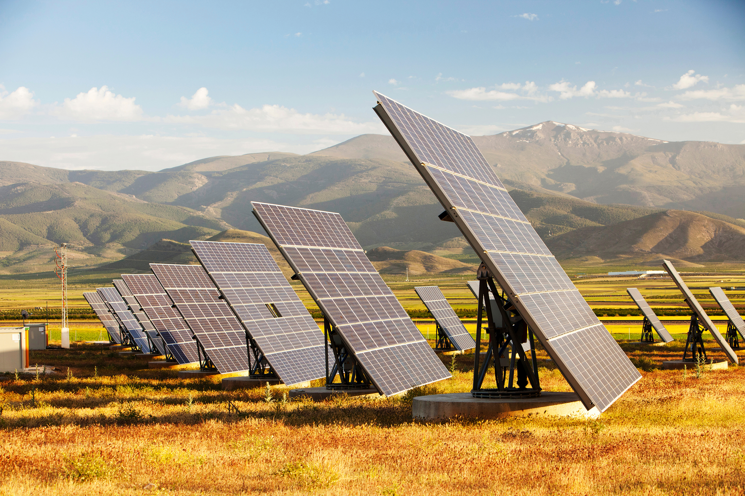
What is a Solar Panel?
A solar panel is a device that generates electricity by harnessing sunlight.
It is also called a photovoltaic (PV) panel due to the conversion of sunlight into electricity using the photovoltaic effect. [1]
The first solar powered device was patented in 1888. [2]

Slide 3
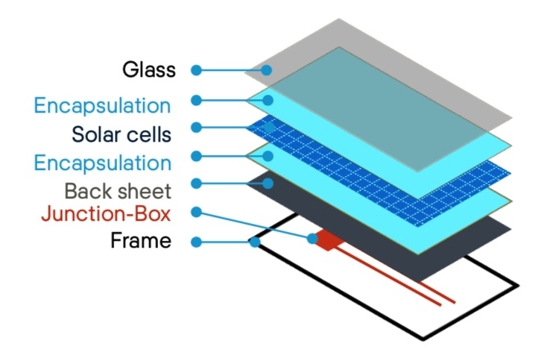
Parts of a Solar Panel
The construction of a solar panel is straightforward. The pieces are listed below. [3]
Solar cells – responsible for converting sunlight into electricity through the photovoltaic effect process. Most are made from silicon semiconductors. [1]
Encapsulations – adhesive used to connect the solar cells to the glass and the backsheet.
Solar glass – sits on top of the solar cells to provide protection against extreme heat absorption.
Backsheet – attaches to the back of the panel to provide protection against other electrical components.
Frame – provide addition support to the structure to prevent damages from wind, rain, and dust. Usually made from aluminum due to its strength and light weight. [3]
Junction box – holds the wires that connects the solar panel to the power source.
Interconnector – used to connect multiple solar panels together.

Slide 4
Photovoltaic Effect
As stated earlier, a solar panel works because of the photovoltaic effect. So, what is this physics phenomenon?
Founded in 1839 by Edmond Becquerel. [4]
Is the process where certain materials have the ability to produce an electrical current or voltage when exposed to sunlight.
Is the fundamental concept that allows solar cells and solar panels to work.

Slide 5
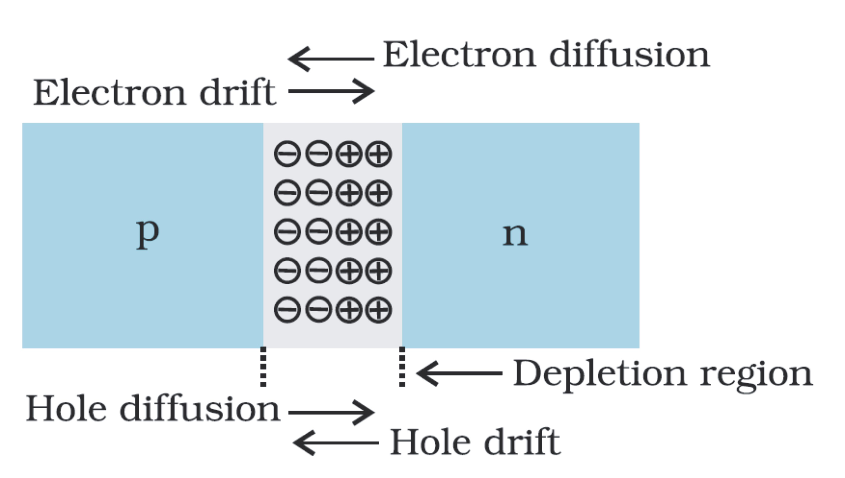
Photovoltaic Effect: P-N Junction
A p-n junction is a boundary within a semiconductor where two differently doped regions (“p” and “n” region) come into contact.
The “p” region is doped with a higher concentration of positively charged regions (holes).
The “n” region is doped with a higher concentration of negatively charged atoms (electrons).
When the two regions come into contact, they form a junction. This junction causes diffusion between the two regions.
Electrons from the n-region diffuse into the p-region, and holes from the p-region diffuse into the n-region.
This diffusion of carriers forms a region called the depletion zone or depletion region. The depletion zone is an area that is void of any free charge carriers, which acts as a barrier to current flow. [5]

Slide 6
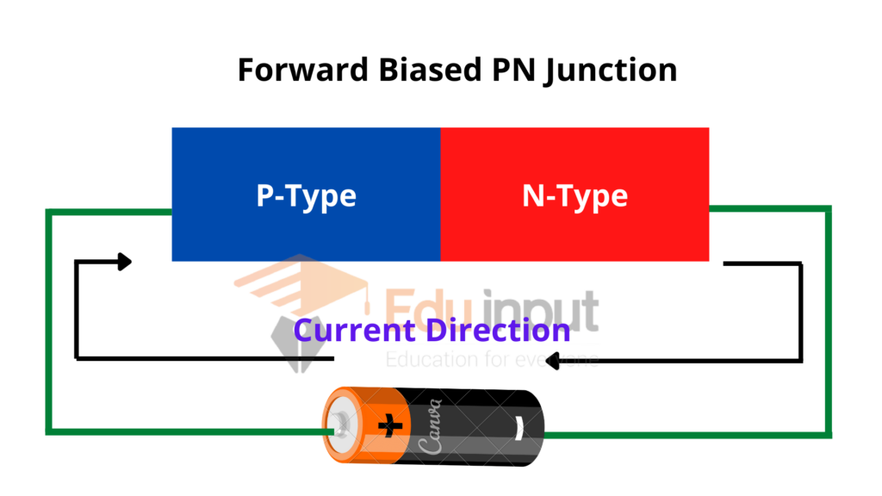
Photovoltaic Effect: P-N Junction
A p-n junction can be forward biased or reverse biased.
When a forward voltage is applied to the p-n junction, where the positive terminal is connected to the p-region, and the negative terminal connected to the n-region, the p-n junction is said to be forward biased.
The width of the depletion region is reduced, which allows for holes and electrons to flow freely, then causing an electrical current.
A p-n junction is said to be reverse biased when the positive terminal is connected to the n-region, and the negative terminal is connected to the p-region.
Reverse bias increases the width of the depletion region, which then restricts the flow of current.

Slide 7
Photovoltaic Effect
Sunlight is composed of tiny particles called photons. The silicon semiconductors allows the solar cell to interact with the photons. [6]
This process causes the electrons to excite and break free, and it creates electron-hole pairs.
Doping semiconductor materials with impurities creates an internal electric field that acts as a barrier. This barrier drives the separated electrons and holes to move in opposite directions, which creates an electric current.
To use the electric current, metal conductors are attached to the solar panel to allow the current to flow to the junction box.
The junction box serves as the connection point between the solar panel and external electrical systems.

Slide 8
Electricity Produced
The collected electricity from the solar panels is routed to the junction box. The electricity produced is DC (Direct Current) electricity but can be converted to AC (Alternating Current) electricity by using an inverter.
DC electricity is fed into the inverter. The inverter then converts the steady DC input into an alternating waveform, typically a sinusoidal waveform resembling the AC power supplied by the electrical grid. This conversion is achieved using electronic components such as transistors or thyristors. [7]
The AC power can then be amplified to a desired voltage level or be synchronized to match other AC power sources.
An inverter is beneficial for solar panels because DC power cannot be used for many applications, such as household appliances, computers, power strips, etc. [8]
Once the electricity is converted, it can be immediately used to power other electrical devices. The electricity can also be stored in batteries for later use, such as when there is no sunlight.

Slide 9
Types of Solar Panels: Monocrystalline
The three most common types of solar panels are monocrystalline, polycrystalline, and thin-film [9]
Monocrystalline solar panels are made from one silicon crystal, hence the name “mono”. These panels are manufactured using high-purity silicon melted and then grown into cylindrical ingots.
An ingot is a chunk of silicon that is produced through crystallization or solidification.
Monocrystalline panels have the highest efficiency of the three common solar panels, and they are most suitable for installations where space is limited, such as residential rooftops.
These panels are the most expensive panels when it comes to fabrication and average cost per watt. [8]

Slide 10
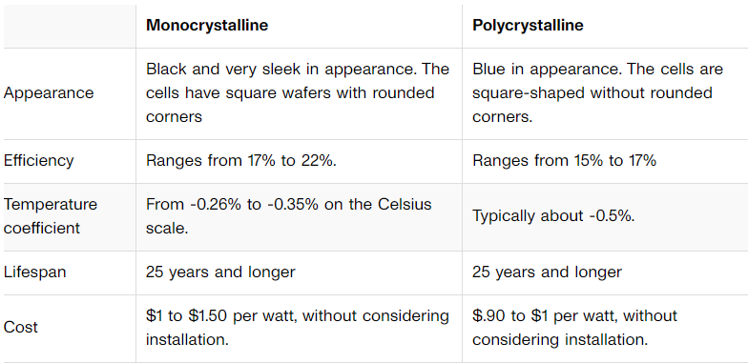
Types of Solar Panels: Polycrystalline
Polycrystalline solar panels are made from multiple silicon crystals. The silicon is melted and cooled into fragments. [9]
Typically, these panels are less efficient than monocrystalline panels, but are also cheaper.
If there is ample room on a rooftop, such as an industrial/commercial building, polycrystalline are more effective.
Table from cnet.com [8]

Slide 11
Types of Solar Panels: Thin-Film
Thin-film solar panels are the third most popular solar panel. They are flat, flexible, and lightweight. They do not use silicon like monocrystalline and polycrystalline solar panels.
They are the least efficient of the three common solar panels, so they are not used for many residential facilities. They are best used when there is a great amount of space to put solar panels, and in places with high temperatures. A solar farm is a good example of where thin-film panels could be used.
Thin-film solar panels can use many different materials for their semiconductors, such as amorphous silicon (a-Si), cadmium telluride (CdTe), and Copper Indium Gallium Selenide (CIGS). [8]
By using these different materials, the efficiency and longevity of the solar panels can be altered.

Slide 12
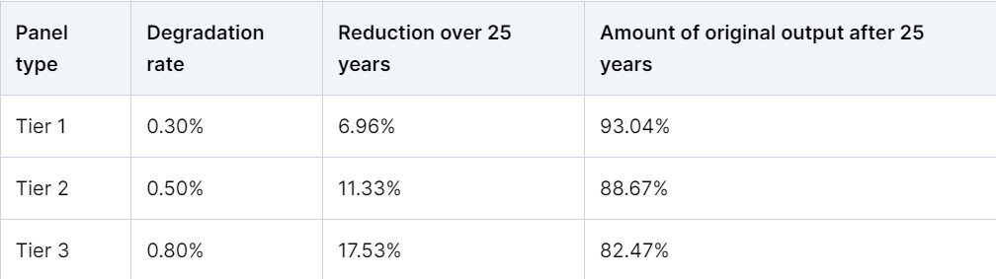
Life Expectancy of Solar Panels
A solar panel has a typical life expectancy of 25 years, although there is no hard expiration date for solar devices. [10]
Harsh environmental conditions, such as extreme temperatures and humidity, can lead to deterioration of solar panels over time.
Moisture can lead to corrosion of certain parts of solar panels, such as the frame and the backsheet.
Although solar panels can have normal wear and tear, proper installation and preventative maintenance allows for more durability.
Table from solarreviews.com [9]

Slide 13
Benefits of Solar
Renewable energy – energy from the sun is readily available everywhere on the planet. This energy also does not produce any pollutants or greenhouse emissions, resulting in a clean energy.
Cost savings – solar panels can minimize the amount of electricity needed to be purchased from the grid. They generate energy from the sun at little to no cost. They also provide energy in the case of a power emergency, such as the electrical grid having a shutdown.
The installation of solar panels can be expensive, but taxpayers can receive a 30% tax credit on their income taxes based on the cost of the solar panels, according to the federal residential solar tax credit. [11]
Scalability – solar panels are suitable for installation in a variety of places. They can be placed on top of tall buildings in cities, parking garages, and many other places that do not serve any great purpose.

Slide 14
Future of Solar Energy
The future of solar energy is very promising with a potential for widespread adoption.
More research and development on solar panels has been stressed to increase their efficiency, which will allow them to convert more sunlight into useable electricity.
In 2022, solar generated 12 times the power that it did in 2013. This power in 2019 was enough to power 19 million homes in the United States. [12]
As technological innovations continue to arise, solar energy is expected to become more cost effective for consumers. [13]
Solar energy will be integrated into new construction plans (rooftops, windows) to provide energy generation and implement an aesthetic look.
Solar will play a crucial role in building smart grids across the country, which can allow for cleaner and more efficient energy generation and consumption.

Slide 15
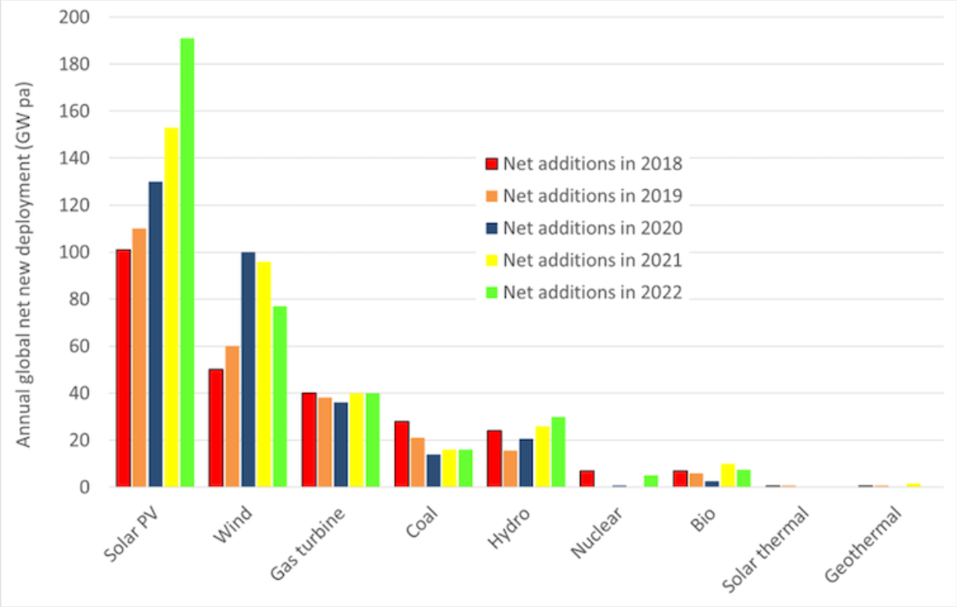
Future of Solar Energy
Histogram from World Economic Forum

Slide 16
Other Ways to Use Solar Energy
Solar water heater – captures sunlight to heat water
Solar heating and cooling – uses solar collectors, heat pumps, and thermal storage to provide heating and cooling
Transportation – used to power electric vehicles (EVs) by integrating panels into the roof of vehicles
Emergency backup – reliable backup power during grid outages and emergencies

Slide 17
References
[1] https://www.energysage.com/solar/solar-panels-work/
[2] https://www.smithsonianmag.com/sponsored/brief-history-solar-panels-180972006/
[3] https://solvoltaics.com/solar-panel-components/
[4] https://energyeducation.ca/encyclopedia/Photovoltaic_effect
[5] https://www.allaboutcircuits.com/textbook/semiconductors/chpt-2/the-p-n-junction/
[6] https://www.energysage.com/solar/solar-photovoltaic-cells/
[7] https://www.energy.gov/eere/solar/solar-integration-inverters-and-grid-services-basics
[8] https://solarmagazine.com/solar-inverters/
[9] https://www.thisoldhouse.com/solar-alternative-energy/reviews/types-of-solar-panels
[10] https://www.solarreviews.com/blog/how-long-do-solar-panels-last
[11] https://www.energy.gov/energysaver/articles/5-benefits-residential-solar
[12] https://pv-magazine-usa.com/2023/10/23/u-s-solar-generation-has-grown-12x-in-a-decade/
[13] https://www.energy.gov/eere/solar/articles/2030-solar-cost-targets#:~:text=To%20accelerate%20the%20deployment%20of%20solar%20power%2C%20SETO,2030%20LCOE%20targets%20to%20their%20corresponding%20historical%20values.

